Slide 1
EVS Stand Up for Education

Slide 2
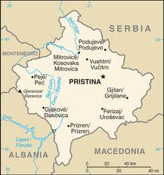
KOSOVO
General Information
Area: 10.887 kmq
Population: 1.733.872
Capital: Pristhina
Official languages: Albanian, Serbian
Ethnic Groups: Albanians (92%), Serbs (8%), Bosniaks, Gorani, Roma, Turks, Ashkali and Balkan Egyptians
Main Religions: Islam, Christianity
Kosovo is the youngest Country in Europe

Slide 3
Background
Kosovo is a self-proclaimed independent Republic from 17 February 2008
Recognized by some states, but not by the UN or by Serbia, which considers it as is own province.
Since the end of the conflict in 1999, Kosovo has been administered by the UN, through the UNMIK based on resolution 1244.
The day before the declaration of independence, the European Union approved the EULEX’s mission which has replaced UNMIK after the transition period.
Notes:
Fondamentale per capire il contesto in cui ci troviamo ad operare e’ conoscere la storia del Kosovo.
Il Kosovo è una Repubblica indipendente autoproclamata (riconosciuta da alcuni Stati, ma non dall'Onu né dalla Serbia, che lo considera a tutti gli effetti una sua provincia) dal 17 febbraio 2008. Dalla fine del conflitto del 1999 il Kosovo è stato amministrato dall'Onu, attraverso la missione Unmik (United Nation Mission in Kosovo), basata sulla risoluzione 1244. Il giorno antecedente la dichiarazione di indipendenza, l'Unione Europea ha approvato la missione Eulex (European Union Rule of Law Mission in Kosovo) che, inviata dalle autorità di Pristina, ha sostituito Unmik dopo il periodo di transizione.

Slide 4
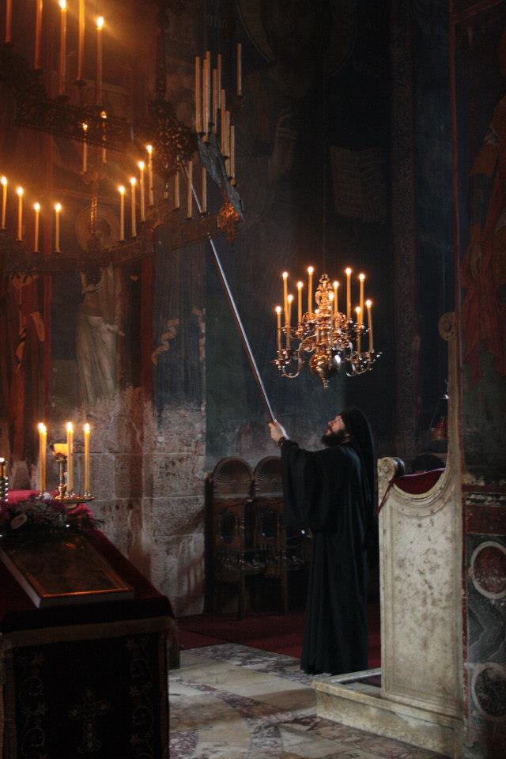
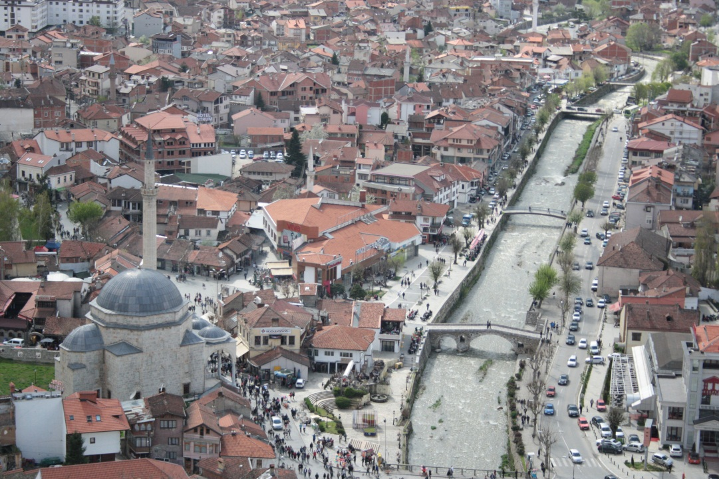
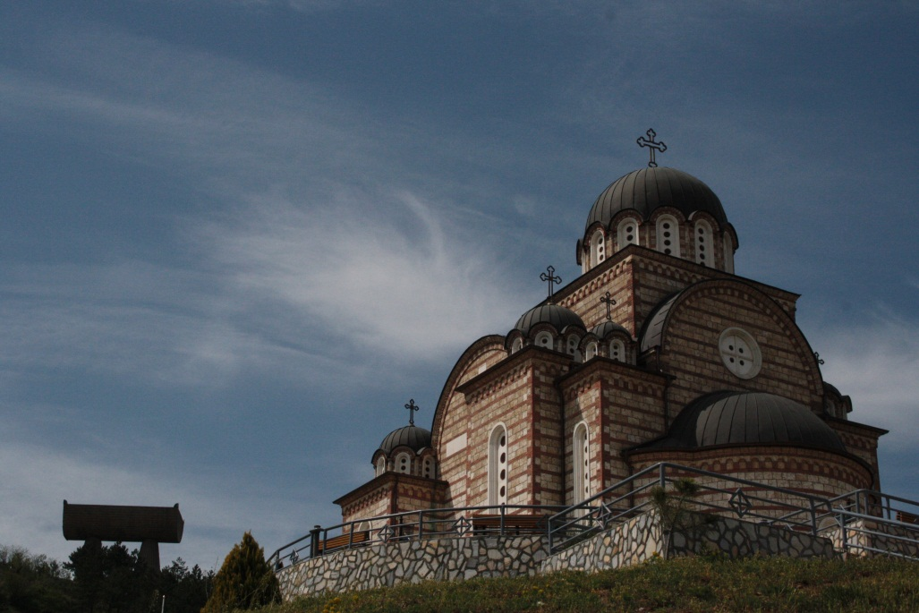
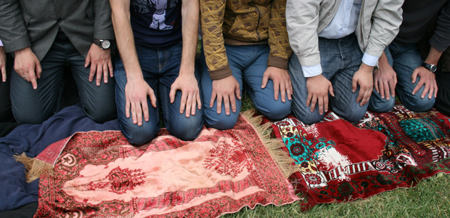
General overview of Kosovo

Slide 5
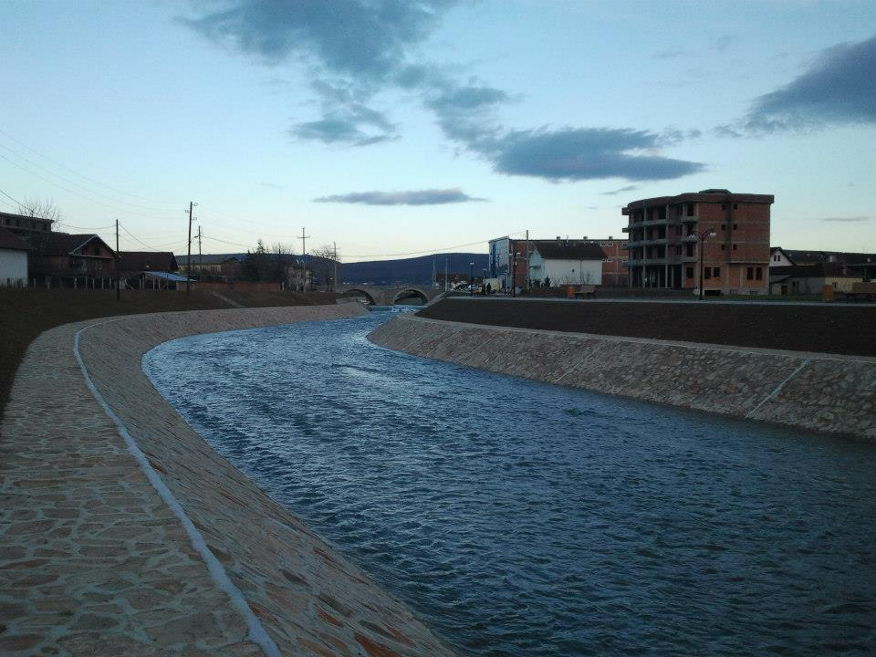
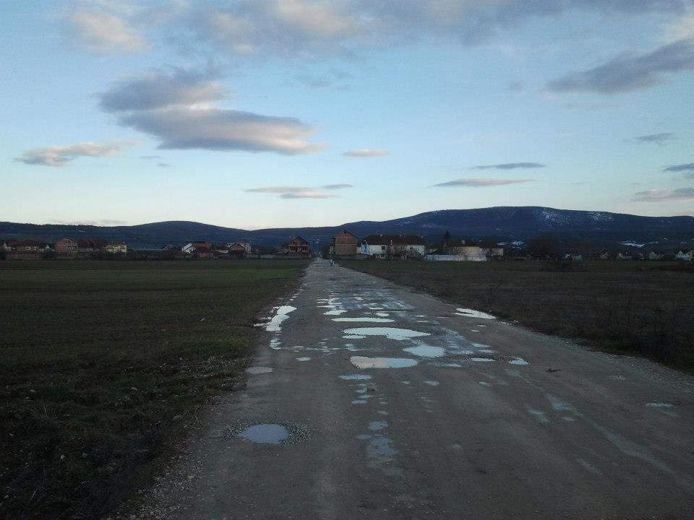
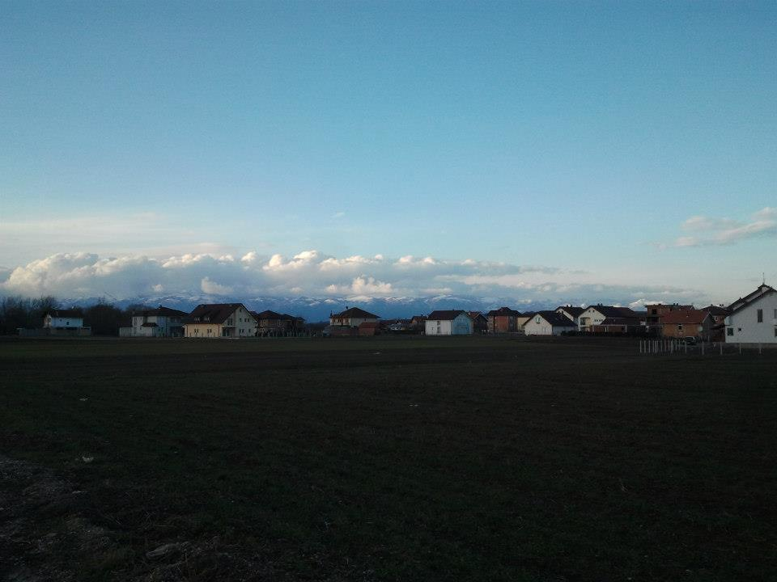
Klinë/Klina
54 villages for a total population of about 38.000
Children aged between 3-5 years was approximately 2.100
There are 12 primary schools and two kindergartens attended by only 100 kids.
Notes:
Klinë/Klina Municipality is composed by 54 villages, the number of tenants is about 38.000 and in 2012 the number of children aged between 3-5 years was approximately 2.100. There are 12 primary schools and three kindergartens but only 100 kids attend preschool.
Even though, over the last few years, there has been an increase in the number of children enrolled on preschool institutions, Klinë/Klina has a low inclusion rate. This situation is due to a different number of causes.

Slide 6
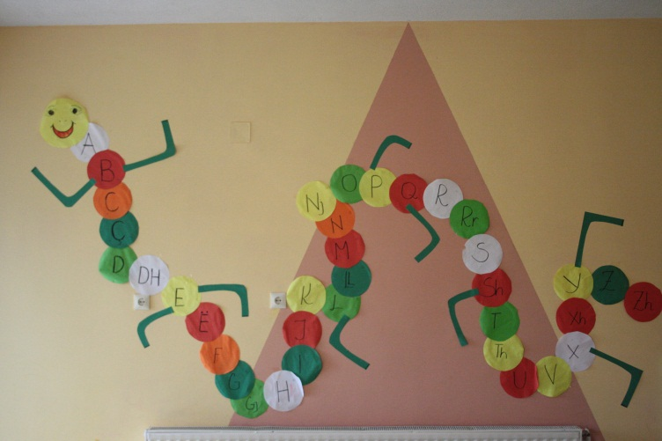
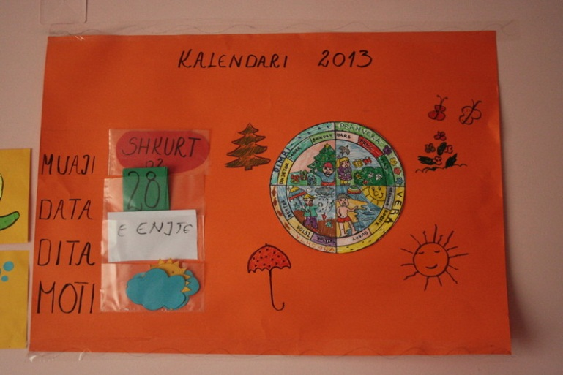
Main Reasons of low attendance
Rural culture
Families prefer to educate their child at home, under the supervisor of the mother or the grandmother.
Undervalue of the early childhood education
Difficult for families to afford the cost of the rent
Notes:
The main reason is linked to the traditional culture, indeed families prefer to educate their child at home, under the supervisor of the mother or the grandmother. They don’t understand the importance of a preschool education and the consequences that this kind of instruction will have to the future schooling of their kids. Another cause is linked to the low income, which make difficult for families to afford the cost of the rent.

Slide 7
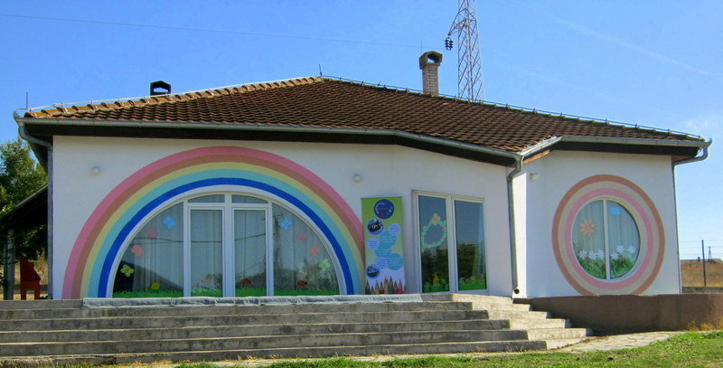
Childproof – CIPOF NGO
CIPOF is a NGO recognized by the Ministry of Public Services in Kosovo. Founded in 2008, it focuses on community development and has goals in education with particular attention to preschool. It is the only organization in Kosovo that own the Maieutica accredited program in preschool, by the Ministry of Education.
The mission of CIPOF is to raise the awareness of the society about the importance of inclusiveness and quality of children education. The Goal is to provide qualitative services for child education.

Slide 8
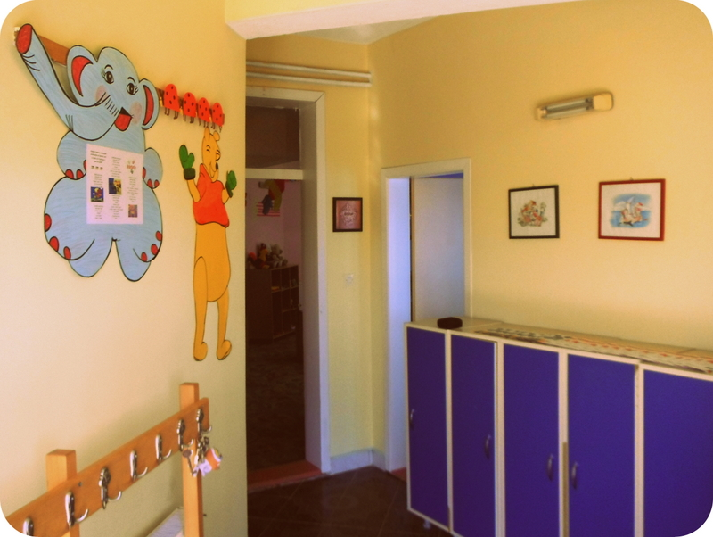
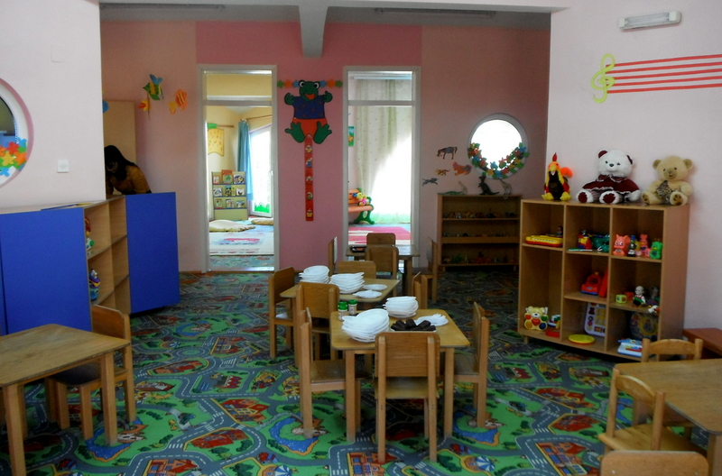
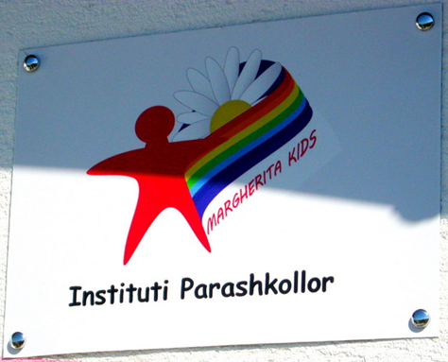
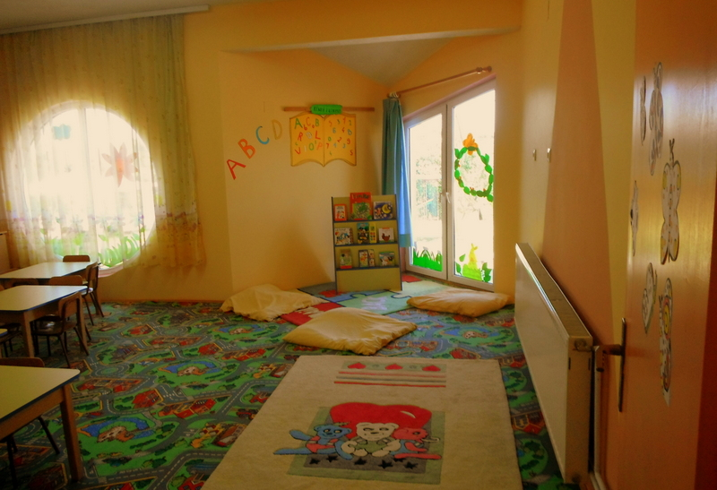
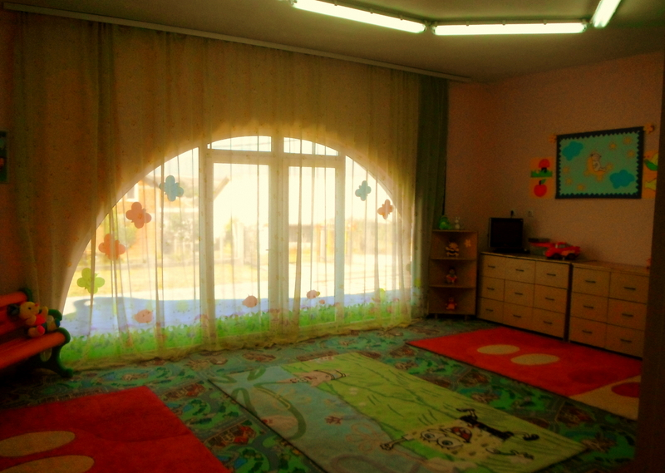

Slide 9
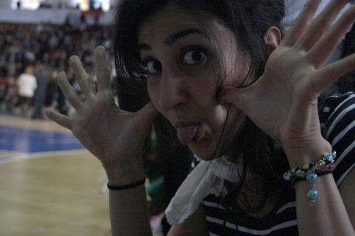
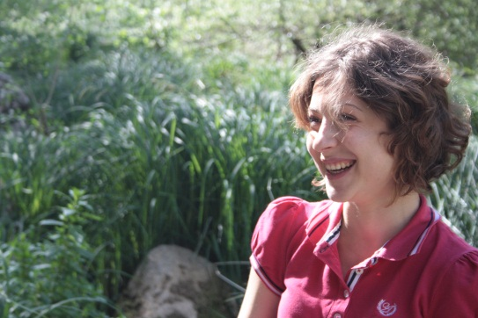
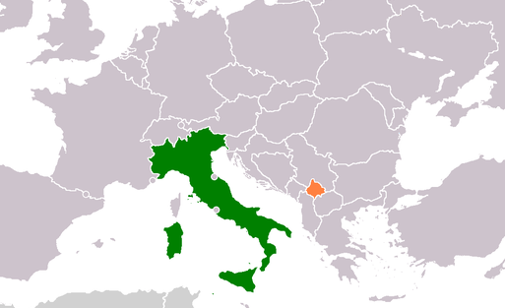
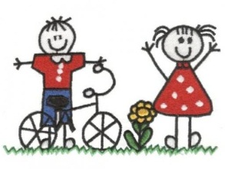
EVS Activities

Slide 10
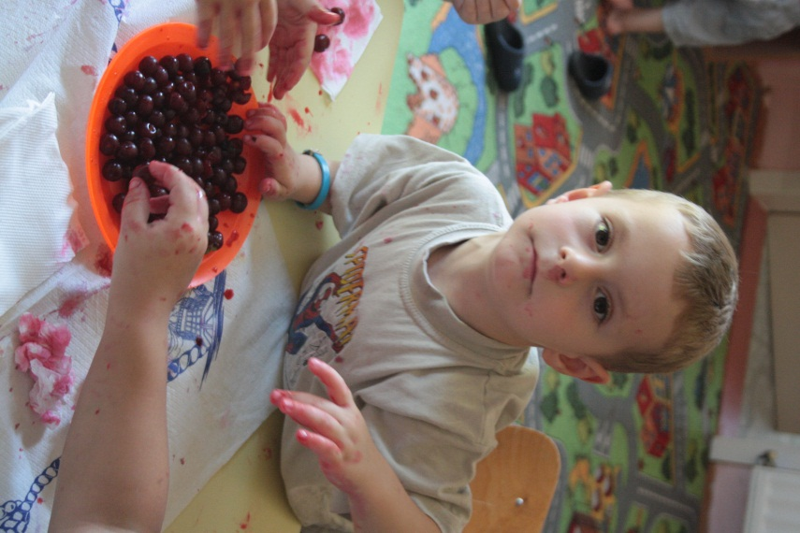
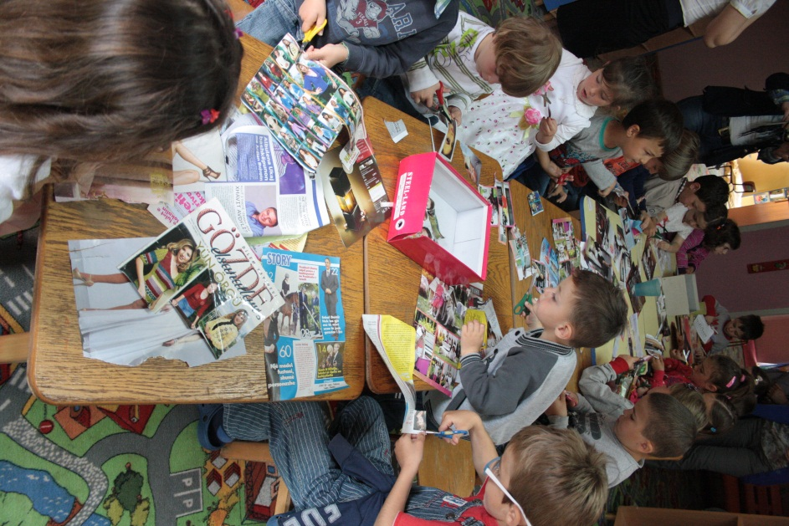
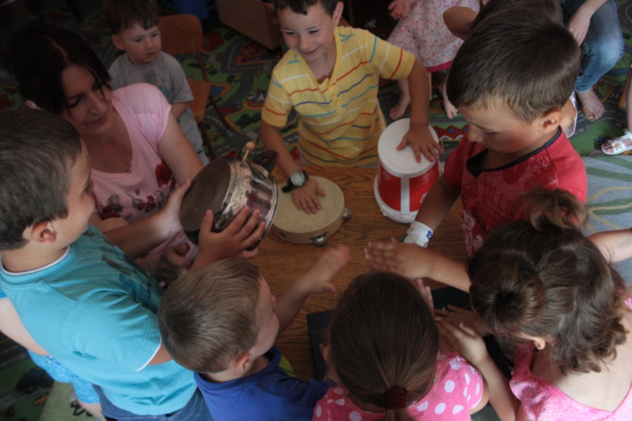
Activity 1 Support in the menagement of the kindergarden Margherita Kids located in Zllakuqan, a rural village on Klinë/Klina municipality.
I. laboratories…

Slide 11
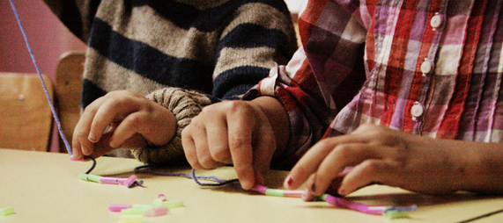
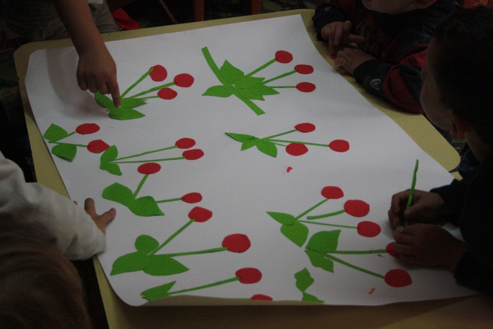
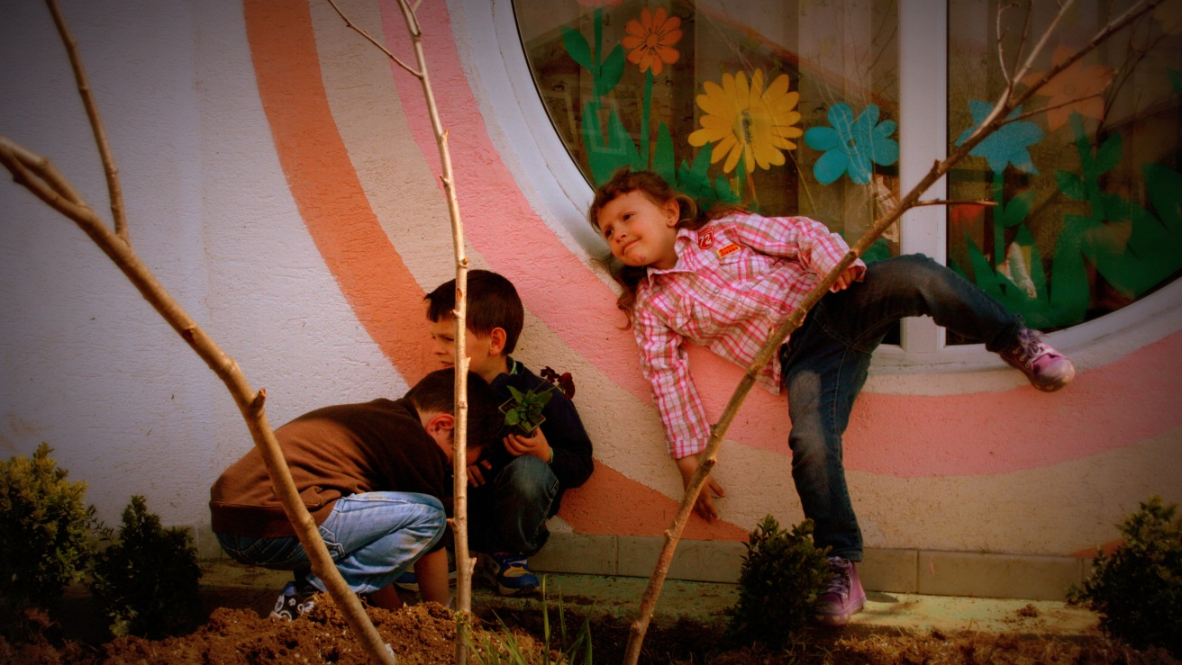
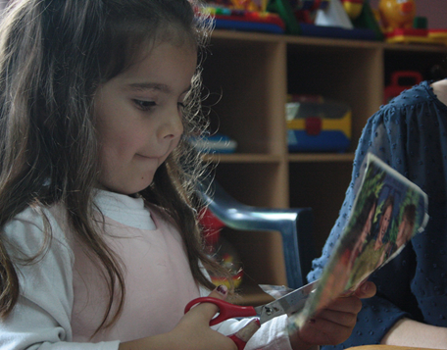
…

Slide 12
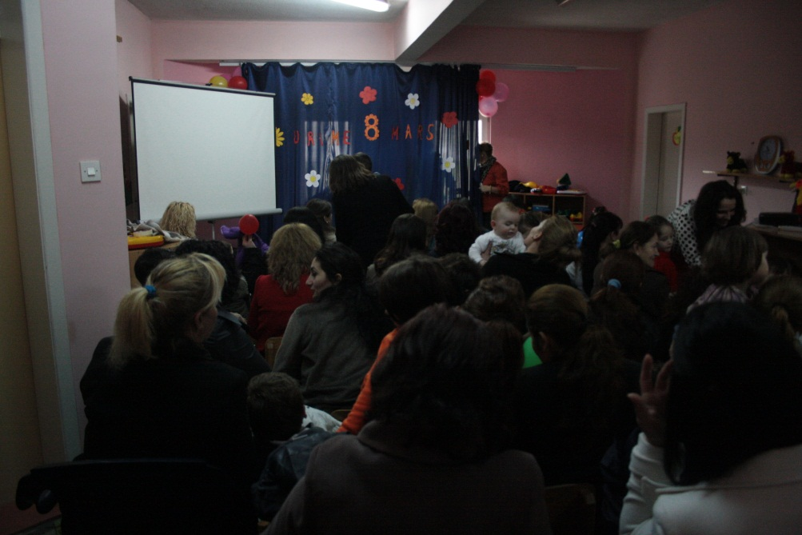
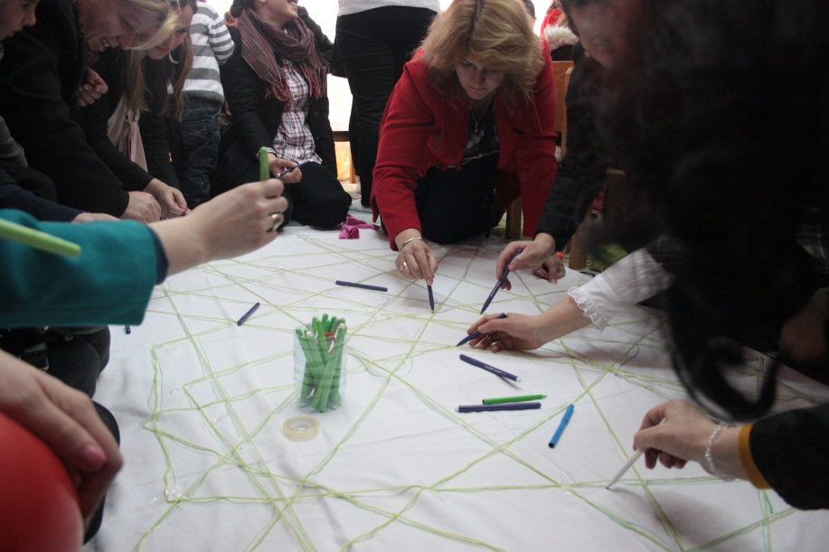
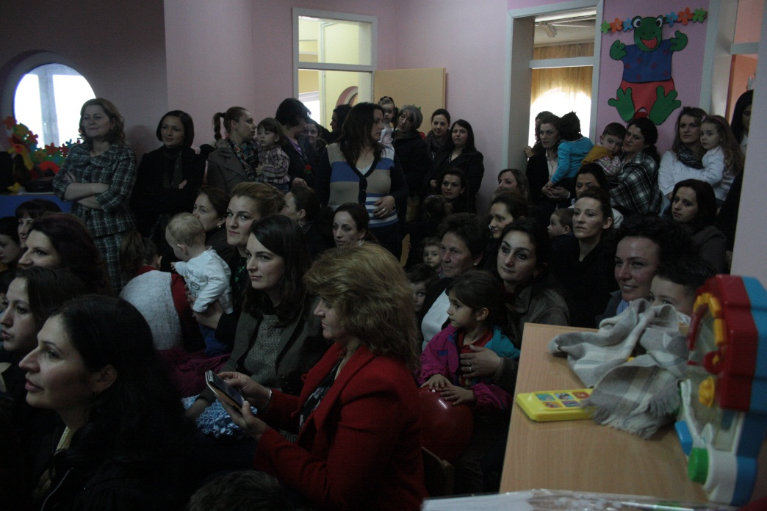
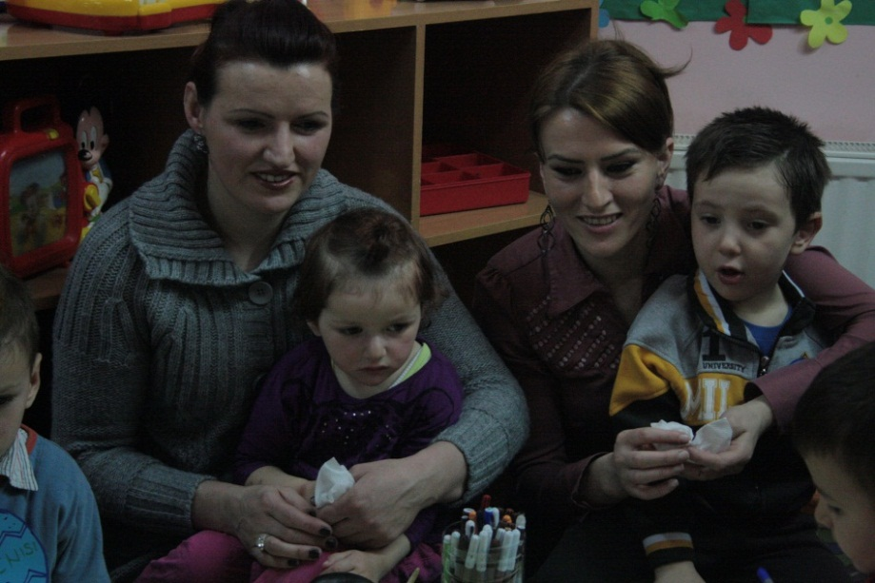
II. awareness campaign with the parents

Slide 13
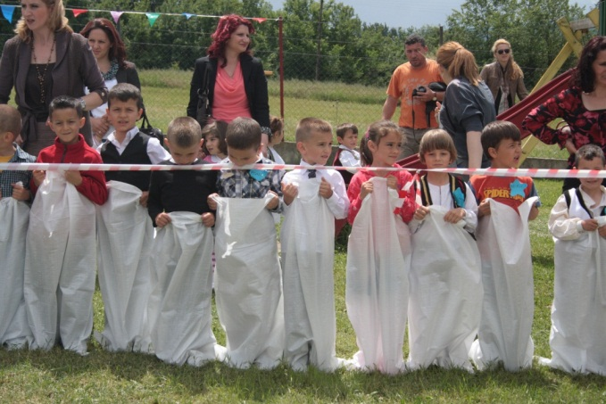
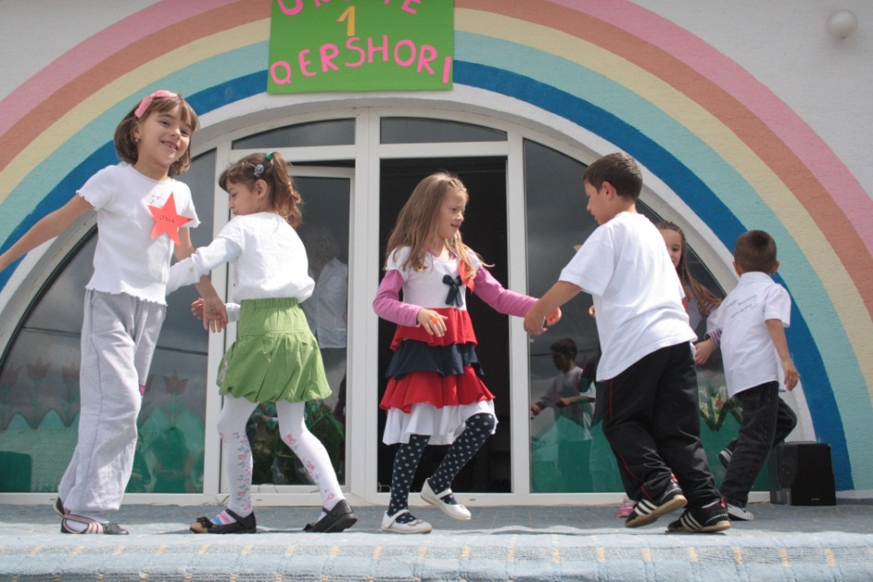
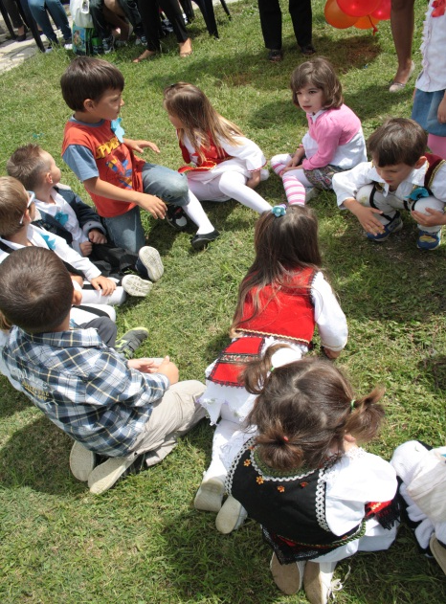
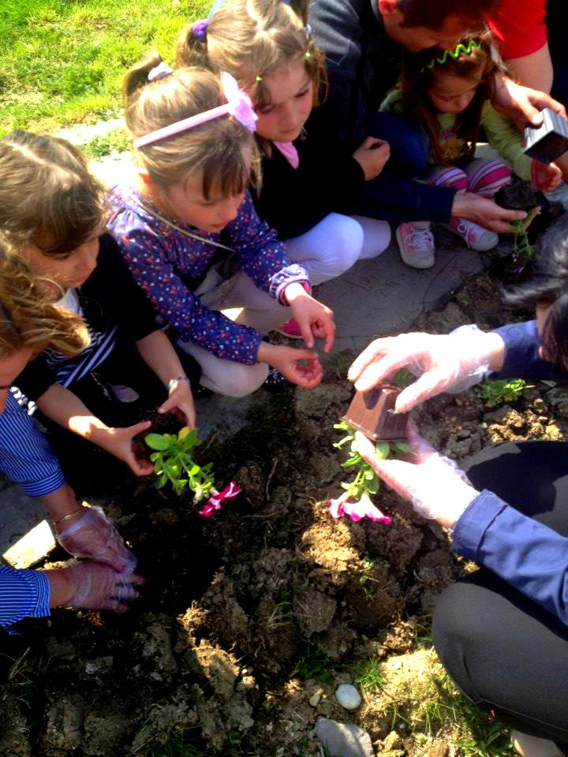
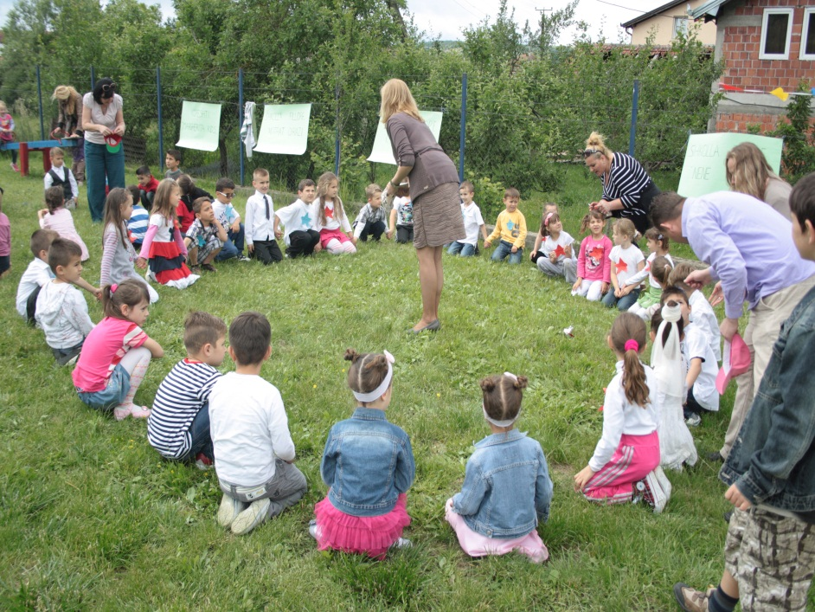
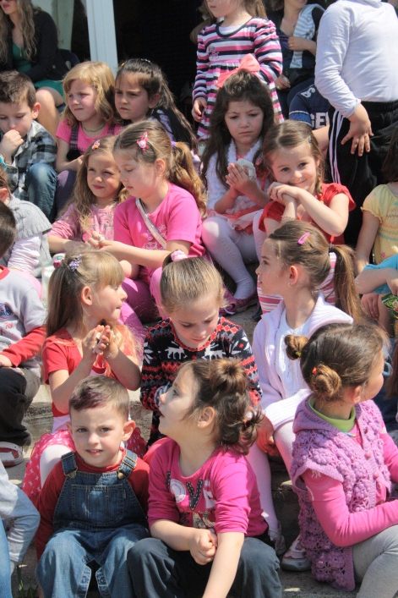
III. Collaboration with other preschools

Slide 14
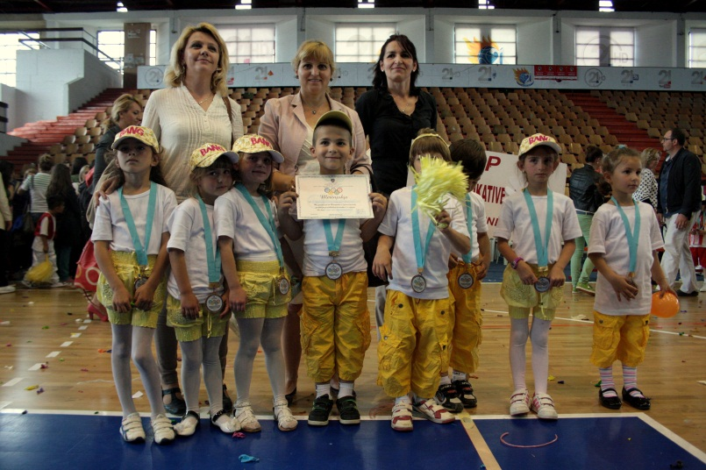
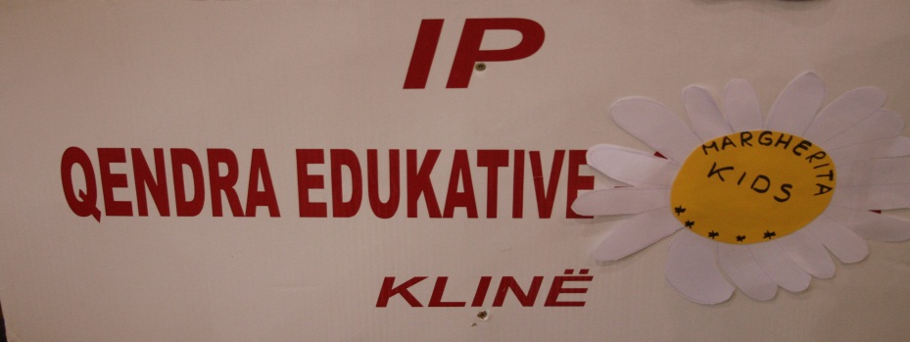
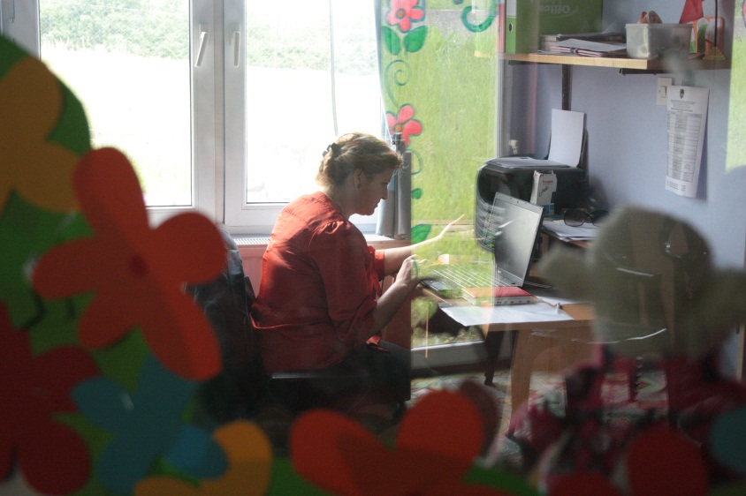
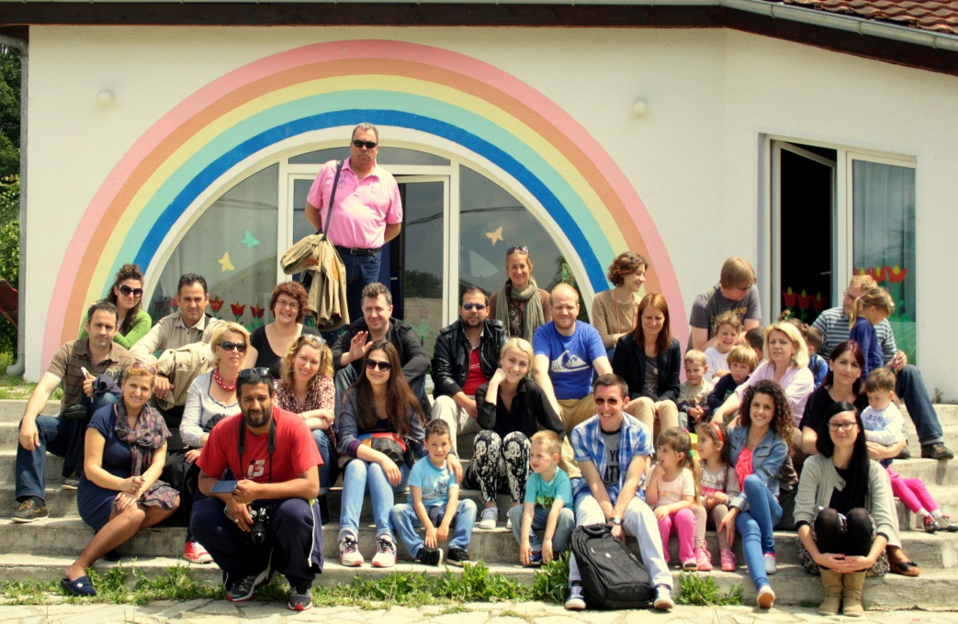
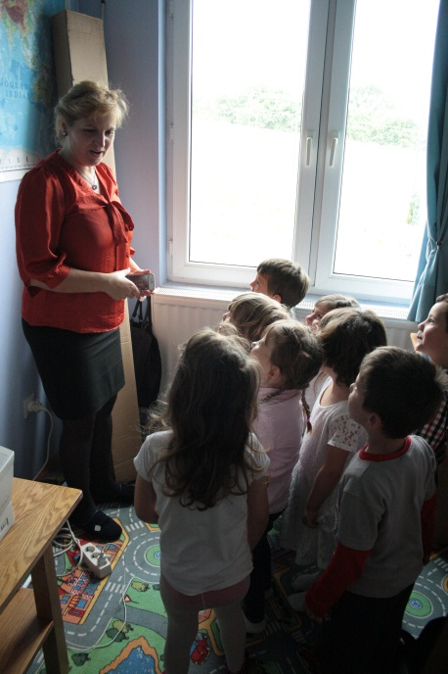
IV. Fundraising
V. Accounting
…

Slide 15
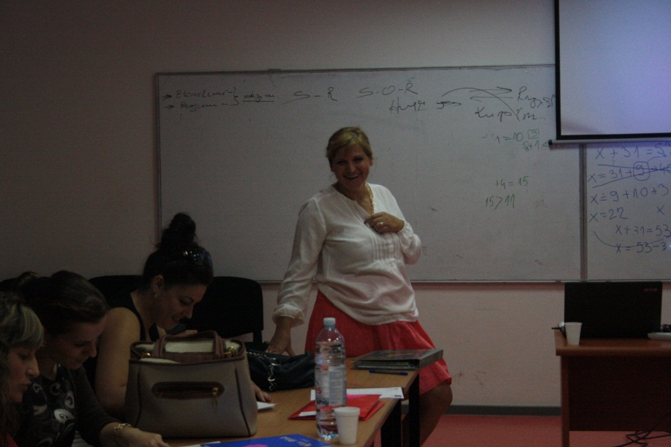
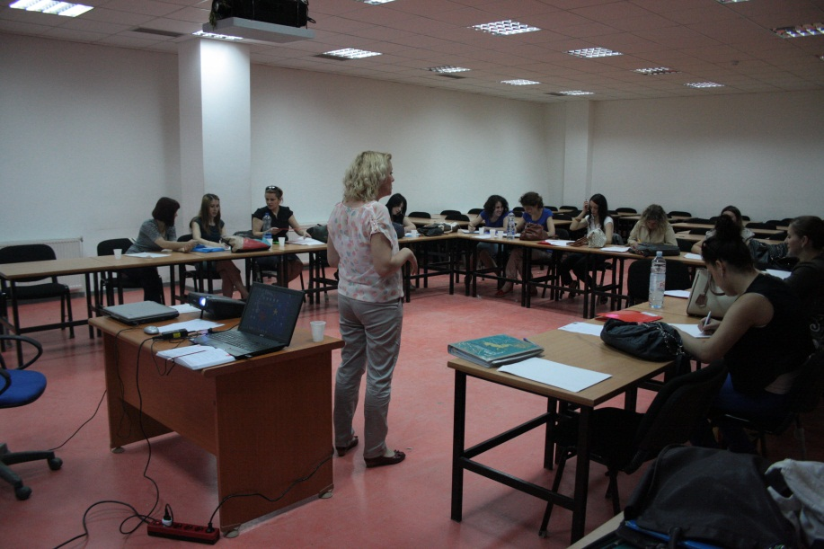
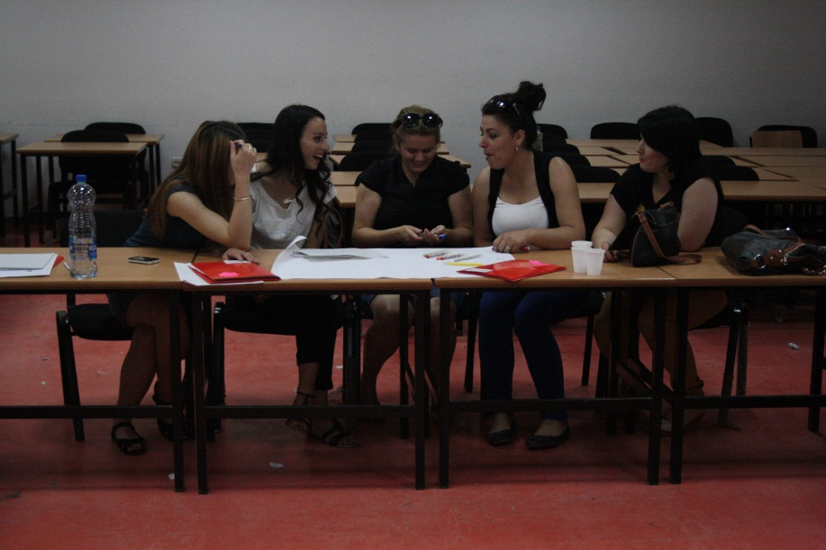
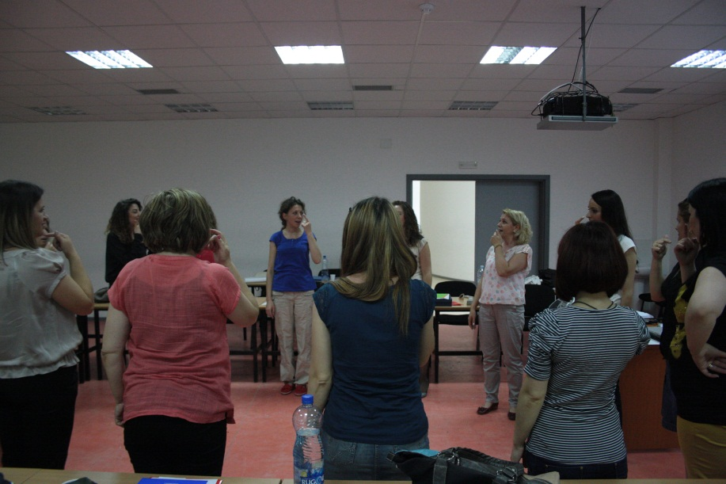
Activity 2: Support in the organization of training classes for educators of public and private preschool institutions in Kosovo.

Slide 16
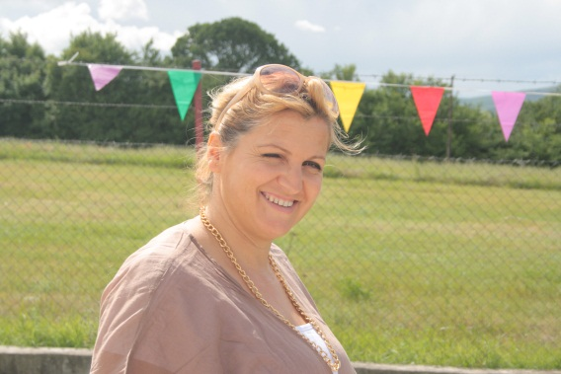
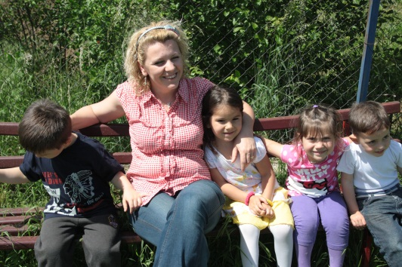
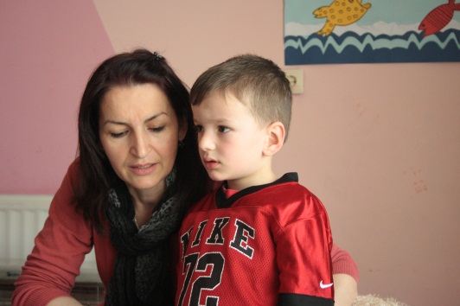
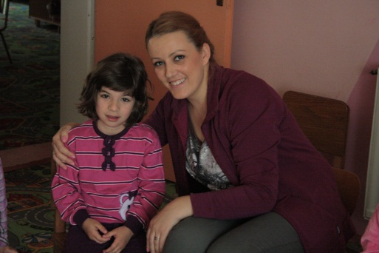
Staff
Mevlude: Director and Supervisor
Merita: educator
Rema: educator
Vlora: support teacher
Kimete: cook

Slide 17
Life in Kosovo

Slide 19
Ditën e Mirë!

